Slide 1
‘It’s just a great day out’
The
TENNANT CREEK
SHOW
2024 Celebrating 45 Years
Show Booklet
45th TENNANT CREEK SHOW
FRIDAY 14TH JULY 2024

Slide 2
More information and updates can be found at
www.tennantcreekshow.com.au

Slide 3
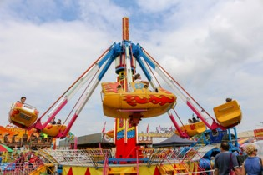
Welcome to the 45th Tennant Creek Show
Events like the Tennant Creek & District Show are important days for our vast Barkly region. The show is an opportunity for everyone to come together from all of our towns, communities, stations and beyond, to relive old fond memories, and to create new ones with family and friends.
The show conjures up different memories for everyone, whether it’s the fear you feel as you hold on tight to the rails of the Cha-Cha, the disappointment that you didn’t quite hit the target to win the massive pink bunny, the moment of excitement as you hear the music of sideshow alley, the immense satisfaction of eating a dagwood dog or some freshly baked scones from the CWA ladies, the overwhelming sense of pride when you see that your entry has won 2nd place and so much more.
Like any small town, it is the people behind the scenes that make community events like this happen. We would like to thank each and every person and organisation that has been a part of the show over the years, it is because of these volunteers that such a remarkable achievement each year can be celebrated. Enjoy each and every moment the show has to offer, and remember, “It’s just a great day out!”
From The Tennant Creek & District Show Society

Slide 5
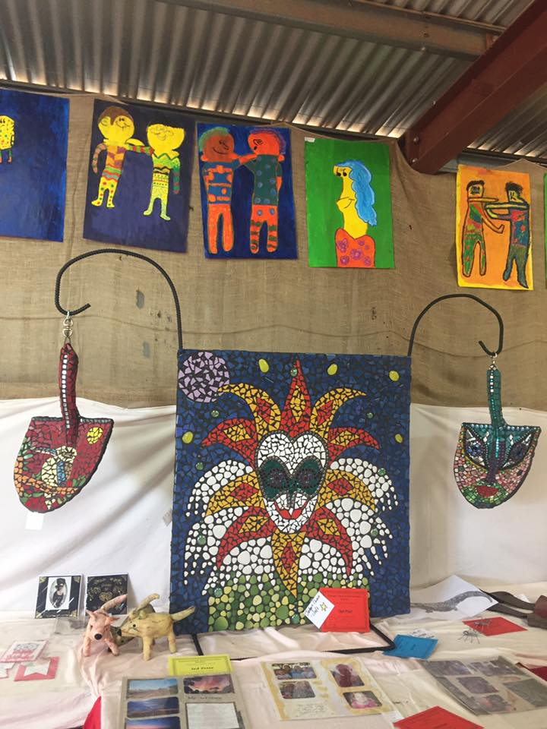
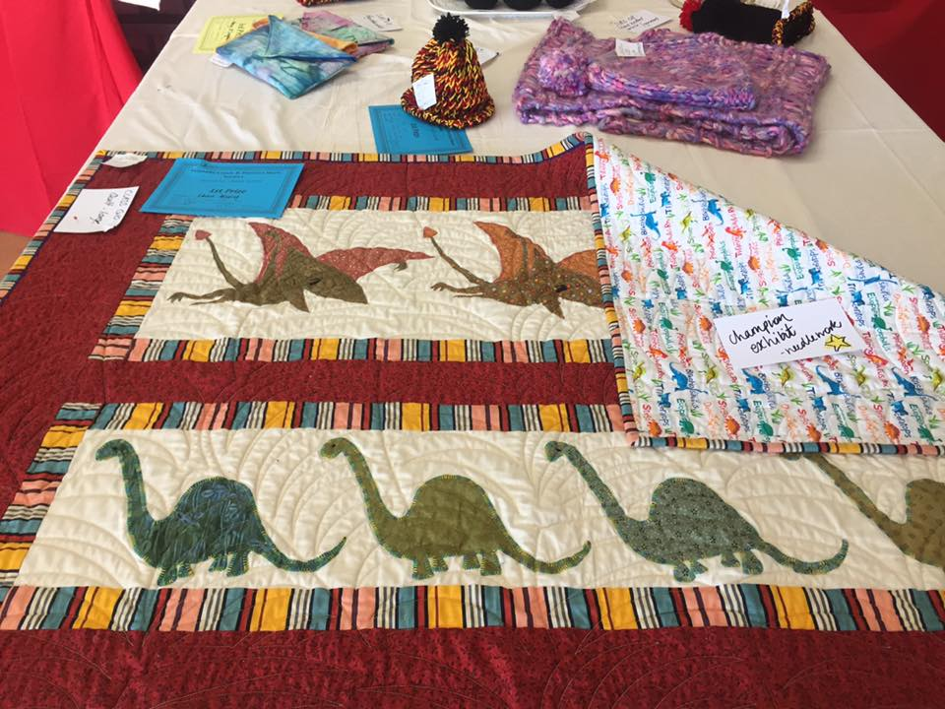
The
TENNANT CREEK
SHOW
Get your entries ready for the next
Tennant Creek Show
ARTS AND CRAFT PAVILLION
Categories include:
Agriculture
Horticulture
Cooking
Needlework
Crafts
Art
Photography
Hobbies & Collections
Entry Fee: $2 per exhibit

Slide 6
The
TENNANT CREEK
SHOW
PRIZES
Overall People’s Choice Award – Prize Money of $100 and Certificate
Donated by ****
OPEN SECTION
Champion Exhibit for each Category - $50 and Certificate
Donated by ****
Best Preserve - $50 and Certificate
Donated by Tennant Creek and District Show Society
1st prize card, 2nd prize card, 3rd prize card
JUNIOR SECTION
Best Junior Exhibit for each Category - $20 and Certificate
Donated by ****
1st prize card, 2nd prize card, 3rd prize card
Special Section Prizes

Slide 7
AGRICULTURE Section D
JUDGE:
DELIVERY: exhibits with entry forms must be delivered to the Steward at the showground no later than 1400 (2pm) on the THURSDAY before Show Day. No late entries will be accepted.
ENTRY FEE: $2 per exhibit
SPECIAL CONDITIONS: Points awarded for presentation. Fruits and Vegetables should be cut from the plant with secateurs, leaving approximately 2cm of stem attached. If there are sufficient entries, additional classes will be created.
PRIZES: 1st prize card, 2nd prize card, 3rd prize card
Open Champion Exhibit $50 / Junior Champion Exhibit $20
ALL ENTRIES MUST BE COLLECTED ON SATURDAY BETWEEN 10AM – 1200PM
AGRICULTURE SECTION D
OPEN VEGETABLES
CLASS D1: Collection of Home-Grown Vegetables (Minimum of 4 varieties)
CLASS D2: Tomatoes – 3 ripe or green
CLASS D3: Root Vegetables – mixed or same variety
CLASS D4: Leafy Vegetables – Cabbage/Lettuce/Spinach/Silver Beet
CLASS D5: Pumpkin – any variety
CLASS D6: Exhibitors Choice
FRUIT
CLASS D7: Citrus Fruit – 3 of same variety
CLASS D8: Fruit – any other variety
CLASS D9: Collection of Fruit – minimum 3 varieties
OTHER
CLASS D10: Cut herbs in bunch
CLASS D11: Eggs – 3 (with saucer to test)
CLASS D12: A collection of Bush Tucker
JUNIOR SECTION 16 Year and under
CLASS D13: Vegetables – any variety
CLASS D14: Fruit – any variety
CLASS D15: Animal Shape made from fruit and/or vegetables (fresh or dried) Individual or Group entry

Slide 8
HORTICULTURE Section E
JUDGE:
DELIVERY: exhibits with entry forms must be delivered to the Steward at the showground no later than 1400 (2pm) on the THURSDAY before Show Day. No late entries will be accepted.
ENTRY FEE: $2 per exhibit
SPECIAL CONDITIONS: Points awarded for presentation. Flowers should be cut from the plant with secateurs.
PRIZES: 1st prize card, 2nd prize card, 3rd prize card
Open Champion Exhibit $50 Junior Champion Exhibit $20
ALL ENTRIES MUST BE COLLECTED ON SATURDAY BETWEEN 10AM – 1200PM
HORTICULTURE SECTION E
OPEN
CLASS E1: Vase of Roses
CLASS E2: One Stem – any flower
CLASS E3: Mixed Flowers – one bunch/vase
CLASS E4: One indoor/outdoor plant in pot
CLASS E5: Bougainvillea – single/double
CLASS E6: One Fern
CLASS E7: Hanging Basket – any variety
CLASS E8: Container of growing cactus/or succulents
CLASS E9: Variety of herbs growing in a container
CLASS E10: Exhibitor’s Choice
FLOWERS IN THE FOLLOWING CLASSES NEED NOT HAVE BEEN GROWN BY THE EXHIBITOR
CLASS E11: Arrangement of any garden flowers and foliage (including dried/native)
JUNIOR SECTION 16 Year and under. Individual or group entries.
CLASS E12: Arrangement of flowers – fresh/dried native
CLASS E13: Fairy Garden

Slide 9
COOKING Section F
JUDGE:
DELIVERY: exhibits with entry forms must be delivered to the Steward at the showground no later than 1400 (2pm) on the THURSDAY before Show Day. No late entries will be accepted.
ENTRY FEE: $2 per exhibit
SPECIAL CONDITIONS: All jams, pickles etc. must be presented in screw top jars. No packet mixes are to be used unless stated in class description. Entries on plates should be in clear plastic or oven bags – NOT coloured plastic or alfoil.
PRIZES: 1st prize card, 2nd prize card, 3rd prize card
Open Champion Exhibit Cooking $50
Open Best Preserve $50
Junior Champion Exhibit $20
ALL ENTRIES MUST BE COLLECTED ON SATURDAY BETWEEN 10AM – 1200PM
COOKING SECTION F
OPEN
CLASS F1: Damper – one loaf made from flour, water, rising agent, salt and water only
CLASS F2: Bread/Rolls (5) – hand made
CLASS F3: Bread/Rolls (5) – machine made
CLASS F4: Cake – any variety – not iced (banana bread/ vanilla cake/ tea cake/sponge etc)
CLASS F5: Cake – any variety – iced (orange cake/hummingbird/chocolate mud cake/carrot)
CLASS F6: Cupcakes/patty cakes/muffins – iced or not iced
CLASS F7: Biscuits (5) – any variety
CLASS F8: Slice (5) – any variety
CLASS F9: Scones (5) – any variety
CLASS F10: Boiled Fruit Cake
CLASS F11: Pie/Quiche – any fillings (except meat)
CLASS F12: Decorated Novelty/Occasion Cake
CLASS F13: Cordial – 1 bottle
CLASS F14: Jam – any variety
CLASS F15: Pickles/Relish/Chutney/Sauce – 1 jar
CLASS F16: Fruit based butter
CLASS F17: Exhibitor’s choice
JUNIOR 5 YEARS & UNDER
CLASS F18: Decorated Arrowroot Biscuits
CLASS F19: Edible Necklace
CLASS F20: Exhibitor’s Choice
JUNIOR 10 YEARS & UNDER
CLASS F21: Packet Cake
CLASS F22: Cupcakes
CLASS F23: Decorated Arrowroot Biscuits
CLASS F24: Edible Necklace
CLASS F25: Exhibitor’s Choice
JUNIOR 16 YEARS & UNDER
CLASS F26: Scones – five plain
CLASS F27: Cake – all varieties
CLASS F28: Cupcakes - decorated
CLASS F29: Decorated Party Cake
CLASS F30: Exhibitor’s Choice

Slide 10
NEEDLEWORK Section G
JUDGE:
DELIVERY: exhibits with entry forms must be delivered to the Steward at the showground no later than 1200 on the WEDNESDAY before Show Day. No late entries will be accepted.
ENTRY FEE: $2 per exhibit
SPECIAL CONDITIONS: Any article which has won a prize in a previous Tennant Creek Show is not eligible.
PRIZES: 1st prize card, 2nd prize card, 3rd prize card
Open Champion Exhibit $50 Junior Champion Exhibit $20
ALL ENTRIES MUST BE COLLECTED ON SATURDAY BETWEEN 10AM – 1200PM
NEEDLEWORK SECTION G
OPEN
CLASS G1: Soft toy/doll – any technique
CLASS G2: Cushion – any technique
CLASS G3: Hat – any technique
CLASS G4: Machined Article/Garment
CLASS G5: Bags/Carry All
CLASS G6: Crocheted Article/Garment
CLASS G7: Creative Embroidery – any medium/any technique
CLASS G8: Hand knitted article/garment
CLASS G9: Quilt – cot size
CLASS G10: Quilt - large
CLASS G11: Cross Stitch – any article
CLASS G12: Patchwork – article/garment
CLASS G13: Felt – any technique/any article
CLASS G14: Any other article
JUNIOR SECTION – 16 & Under
CLASS G15: Article – Knitted/Crocheted/Embroidered/Machined
CLASS G16: Felt – any technique/any article
CLASS G17: Article – made from a kit

Slide 11
CRAFTS Section H
JUDGE:
DELIVERY: exhibits with entry forms must be delivered to the Steward at the showground no later than 1200 on the WEDNESDAY before Show Day. No late entries will be accepted.
ENTRY FEE: $2 per exhibit
SPECIAL CONDITIONS: Any article which has won a prize in a previous Tennant Creek Show is not eligible.
PRIZES: 1st prize card, 2nd prize card, 3rd prize card
Open Champion Exhibit Cooking $50 Junior Champion Exhibit $20
ALL ENTRIES MUST BE COLLECTED ON SATURDAY BETWEEN 10AM – 1200PM
CRAFTS SECTION H
OPEN | 16YRS & UNDER
CLASS H1: Metal work CLASS H2: Wood work CLASS H3: Pottery/ceramic CLASS H4: Fabric Article – decorated/painted CLASS H5: Handmade jewellery CLASS H6: Wall hanging – any medium CLASS H7: Sculpture – any medium CLASS H8: Toy – hand/machined made CLASS H9: Paper craft/tole/mâché/decoupage CLASS H10: Scrapbooking CLASS H11: Card – 3 handmade CLASS H12: Article from recycle materials CLASS H13: Mosaic – any item CLASS H14:Diamond painting CLASS H15: Resin craft – any item CLASS H16: Exhibitor’s Choice CLASS H17: Group Project – any article/any medium | CLASS H26: Sculpture CLASS H27: Pottery CLASS H28: Woodwork item CLASS H29: Decorated Fabric Work – Painting/Printing/Dyeing – any medium CLASS H30: Artificial Floral Display CLASS H31: Exhibitor’s Choice
JUNIOR 10 YRS & UNDER
CLASS H18: Decorated Pet Rock
CLASS H19: Egg Carton Creature
CLASS H20: Decorated Wooden Spoon
CLASS H21: Play Dough 5yrs & under. Any article must be of a solid construction
CLASS H22: Play Dough 6yrs & over: Any article must be of a solid construction
CLASS H23: Group entry – Childcare to Grade 2 – any article/any medium
CLASS H 24: Group entry – Grade 3-6 – any article/any medium
CLASS H25: Exhibitor’s Choice

Slide 12
ART Section L
JUDGE:
DELIVERY: exhibits with entry forms must be delivered to the Steward at the showground no later than 1200 on the WEDNESDAY before Show Day. No late entries will be accepted.
ENTRY FEE: $2 per exhibit
SPECIAL CONDITIONS: Any article which has won a prize in a previous Tennant Creek Show is not eligible.
PRIZES: 1st prize card, 2nd prize card, 3rd prize card
Open Champion Exhibit Cooking $50 Junior Champion Exhibit $20
ALL ENTRIES MUST BE COLLECTED ON SATURDAY BETWEEN 10AM – 1200PM
ARTS SECTION L
OPEN
CLASS L1: Landscape – any medium
CLASS L2: Portrait – any medium
CLASS L3: Still Life – any medium
CLASS L4: Mixed media - collage
CLASS L5: Charcoal drawing
CLASS L6: Print – any subject, any style (screen, lino, etching, lithograph, etc)
CLASS L7: Indigenous Art – any subject, any style
CLASS L8: Computer Generated – any media
CLASS L9: Other – Pastel, Water Colour, Pencil, Inks
JUNIOR
Pre-school – Grade 2 | 16 yrs and under
CLASS L10: Collage CLASS L11: Printing CLASS L12: Painting CLASS L13: Drawing CLASS L14: Group Entry – any medium – Grade 2 | CLASS L20: Collage CLASS L21: Printing CLASS L22: Painting CLASS L23: Drawing CLASS L24: Computer Generated – any media
Grade 3-6
CLASS L15: Collage CLASS L16: Printing CLASS L17: Painting CLASS L18: Drawing CLASS L19: Group Entry – any medium – Grades 3-6

Slide 13
PHOTOGRAPHY Section M
JUDGE:
DELIVERY: exhibits with entry forms must be delivered to the Steward at the showground no later than 1200 on the WEDNESDAY before Show Day. No late entries will be accepted.
ENTRY FEE: $2 per exhibit
SPECIAL CONDITIONS: Any exhibit may only be entered in one class. All classes will be judge on composition, technical quality and relevance to the subjected of the lass entered. Prints must be mounted on card suitable for pinning.
PRIZES: 1st prize card, 2nd prize card, 3rd prize card
Open Champion Exhibit $50 Junior Champion Exhibit $20
ALL ENTRIES MUST BE COLLECTED ON SATURDAY BETWEEN 10AM – 1200PM
PHOTOGRAPHY SECTION M
OPEN
CLASS M1: Art of Landscape – Tennant Creek/Central Australia Landscape
CLASS M2: The Rural Way – pastoral/grazing
CLASS M3: Portrait – individual or group
CLASS M4: Black and White – any subject
CLASS M5: Floral/Plant
CLASS M6: Animal/Wildlife
CLASS M7: Travel – Holiday or Travel photos
CLASS M8: Open Subject
JUNIOR
CLASS M9: Children’s – 10 years and under – any subject
CLASS M10: Young Hot Shots – 16 years and under – any subject
CLASS M11: Selfie – a photograph taken of yourself
CLASS M12: Open Subject

Slide 14
HOBBIES & COLLECTIONS Section N
JUDGE:
DELIVERY: exhibits with entry forms must be delivered to the Steward at the showground no later than 1200 on the WEDNESDAY before Show Day. No late entries will be accepted.
ENTRY FEE: $2 per exhibit
SPECIAL CONDITIONS: Any exhibit may only be entered in one class. Collections to comprise of a group of 5 or more similar items displayed on a tray or board. Lego are to individual designs (NO KITS).
PRIZES: 1st prize card, 2nd prize card, 3rd prize card
Open Champion Exhibit $50 Junior Champion Exhibit $20
ALL ENTRIES MUST BE COLLECTED ON SATURDAY BETWEEN 10AM – 1200PM
HOBBIES & COLLECTIONS SECTION N
OPEN
CLASS N1: Collection of similar items. 5 or more.
JUNIOR
16 YRS & Under
CLASS N2: Collection of similar items (coins/stamps/teacups etc.) 3 or more
CLASS N3: Lego individual design

Slide 15
General Entry Form
The Secretary / PO Box 515 Tennant Creek NT 0861 I hereby request that you enter, subject to the rules and regulations of the Show Society, the undermentioned exhibits for your show, to be held on the Society’s grounds. Section ____________________________________ (use a separate form for each section) Name ________________________________________________ Age _____________ Address ______________________________________________ (For 16 Yrs & under) Email ________________________________________ Phone# ___________________
 | Entry # | Class | Description of Entry |  |  | Entry Fee ($2 per entry)
 | 1
 | 2
 | 3
 | 4
 | 5
 | 6
 | 7
 | 8
 | 9
 | 10
 | 11
 | 12
 | 13
 | 14
 |  |  |  |  | Total $
Please note: No late entries. Fees must accompany entry form which must be signed by exhibitor. I declare these entries to be my own and bona fide property. ___________________________________ _______________________ Exhibitor’s Signature Date
Tennant Creek Show Society ph. 08 8962 1251 email. tennantcreekshow.com.au
Tennant Creek Show

Slide 16
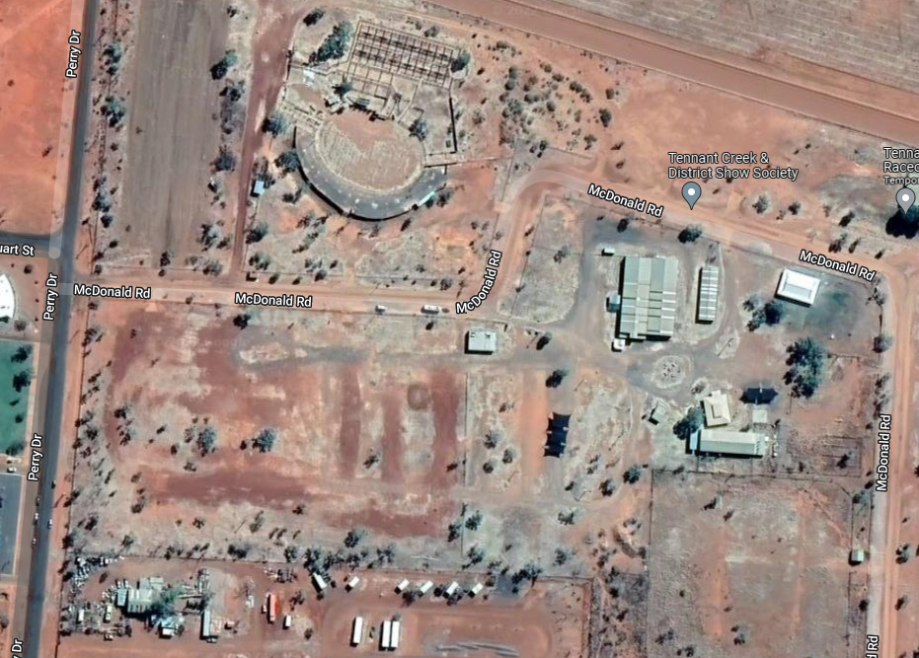
1 | Ticket Booth
2 | Ticket Booth
3 | Parking Area
4 | Public Toilets
5 | Rodeo Arena
6 | Exhibition Pavilion/ATM/First Aid
7 | Show Office
8 | CWA Hall
9 | Art and Craft Pavilion
10 | Sideshow Alley
11 | Live Entertainment Area
12 | Parks and Wildlife
13 | Live Entertainment Area
 | Disability Parking – access via back gate entrance
Show Ground Map
5
3
6
Disability Parking
1
9
7
8
10
4
11
12
13
4
2

